Slide 1
Investment promotion and tourism in Hungary
7th Session of the
Hungarian-Turkish
Joint Committee on Tourism
29 November 2013

Slide 2
Who we are
Introduction of the Hungarian Investment and Trade Agency
Governmental agency for investment promotion and trade development
Main activities: consultancy, mediation, providing information, and around 500 programs yearly
Headquarters in Budapest
150 employees, mainly consultants
Supervising body: Prime Minister’s Office

Slide 3
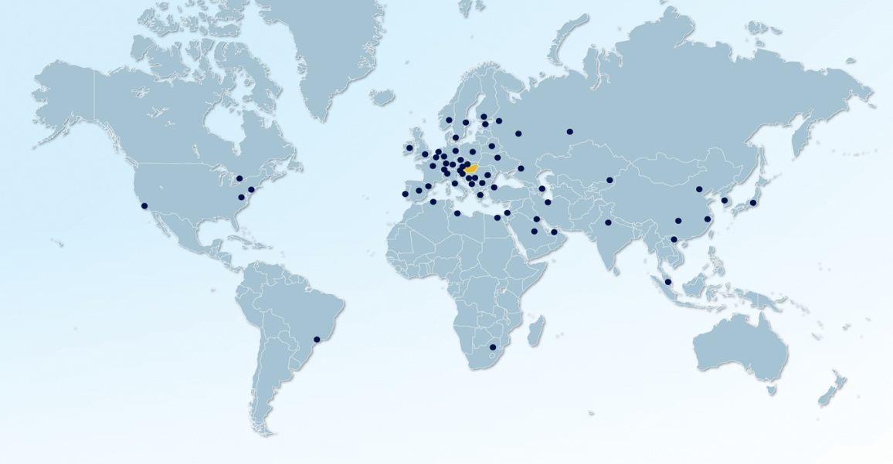
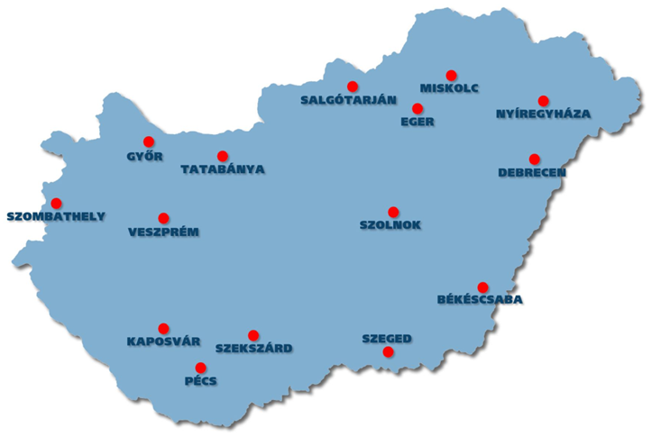
Offices in Hungary and abroad
Domestic network
Central office: Budapest
15 regional offices outside Budapest covering the whole country
Foreign network
61 foreign offices in 47 countries all over the world
74 trade and investment counsellors
Notes:
A Hivatal ügyfélközpontú, helyi szintű tevékenységének biztosítása, igényfelmérés, tanácsadás, információszolgáltatás a beruházások ösztönzése és az üzletfejlesztés terén.
Regionális rendezvények szervezése és lebonyolítása.
Széleskörű kapcsolattartás a helyi hatóságokkal, önkormányzatokkal, szakmai és civil szervezetekkel, vállalkozásokkal, vállalkozói szervezetekkel, médiával.
Kárpát-medencei információs pontok kiépítése, működtetése.
Még egy infó: a regionális hálózatban 34 helyi rendezvényt bonyolítottunk le idén. Beszállítói rendezvények, KGSZ roadshow, exportőr képzések és határon átnyúló regionális üzletember-találkozók.

Slide 4
Our project management services
Pre-decision
Implementation
Operations
Tailored information packages on the economy, industrial sectors, incentives, business environment, supplier network
Assistance in location search and evaluation
Organisation of site visits and partner meetings
Supplier search
Providing information on permitting procedures
Assistance in identifying incentives
Intermediate Body for VIP cash incentive (preliminary information, application)
Expansion assistance
After care services
Intermediary body between the government and the companies
Supplier search

Slide 5
Reasons to invest in the Hungarian
tourism sector
Steady increase in number of foreign visitors
Unique geothermal characteristics
Growth potential in quality accommodation due to lack of
financial capital
Potential in conference tourism especially in regional capitals
Competitive wages in all sectors including tourism

Slide 6
Focus areas within the sector
Health tourism
Around 80% of the country’s surface has access to thermal water
High standard and reasonable price of medical treatments
A globally leading destination in dental tourism
Historical and village tourism
Cultural and world heritage sites (six cultural and two natural locations)
Gastronomy and wine tourism
Special festivals and events
Conference tourism
In 2011 Budapest was ranked 11th among the world’s top conference destinations (source: International Congress & Convention Association (ICCA))

Slide 7
Facts and Figures
Number of people employed in the sector: 400,000
Sector’s contribution to GDP: 8.5 %
Year | Number of visitors (commercial accomodation) | Number of nights spent (commercial accomodation) | Average number of nights spent
2011 | 3.8 million | 10.4 million | 2.7
2012 | 4.1 million | 11.3 million | 2.7
Source: Hungarian Central Statistical Office
Amount of FDI in tourism sector in Hungary (2012)
EUR 416 million
Source: National Bank of Hungary

Slide 8
Hungarian Investment Projects (HIP)
Up-to-date database managed by HITA
Projects from various sectors: agriculture, ICT, electronics, life sciences
40 projects in tourism:
23 related to thermal and wellness
17 related to other areas
EUR 1.23 billion aggregate fund requirement

Slide 9
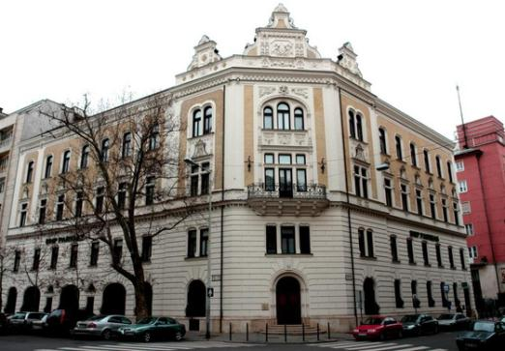
Thank you for your attention!
Contact
Address: 1055 Budapest, Honvéd str. 20.
Phone: +36 1 872 6520
info@hita.hu
www.hita.hu

